Slide 1
Software Quality Assurance and Testing Technology
1st Semester, Fall 2022
Xiaoping CHE (xpche@bjtu.edu.cn)
Associate Professor
School of Software Engineering
Beijing Jiaotong University

Slide 2
Rules
Project 20%
Assignments 40%
Final Exam 40%

Slide 3
How
16 Weeks Plan
Week 1: The basic concepts and theories of testing
Week 2-3: Principles of Testing
Week 4-5: White Box Testing
Week 6-8: Black Box Testing
Week 9-10: Unit Testing & Integration Testing
Week 11: System Testing
Week 12: Regression Testing
Week 13-14: Software Testing Management
Week 15: International and Local Testing
Week 16: Future of Testing

Slide 4

How
References
Ron Patton, Software Testing (2th Edition)
Glenford J. Myers, The Art of Software Testing (3rd Edition)
Gerald M. Weinberg, Perfect Software

Slide 5
OVERVIEW OF CLASSIFYING TESTS
BLACK-BOX: No knowledge of the internal logic of the code is utilized. Tests are based on requirements and functionality.
WHITE-BOX: Tests are designed based on the internal logic of the code, code coverage considerations, and analysis of branches, paths, loops, and conditions
UNIT: Test at the function or module level. May require test drivers or test harnesses.
INCREMENTAL INTEGRATION: Continuous testing as new functionality is added. May need test drivers. Testing combined parts of an application to see if the parts function together properly.
REGRESSION: Re-testing after fixes or modifications of software or the environment.

Slide 6
TEST PHASES
COMPARISON: Compares weaknesses and strengths to competing products.
ALPHA: Testing when development is nearing completion; minor design changes may be required.
BETA: Development and testing viewed as completed and looking for final bugs and problems before final release.

Slide 7
CLASSIFYING TESTS
FUNCTIONAL: Black-box testing geared to check functional requirements of an application.
SYSTEM: Black-box testing that is based on overall requirements and specifications.
STRESS: Often used interchangeably with ‘load’ and ‘performance’. But, others believe tests should check functionality under extreme conditions.
PERFORMANCE: Often used interchangeably with “load” and ‘stress’.
LOAD: Test under heavy loads to determine at what point a system’s response time degrades or fails
END-TO-END: Testing that mimics real-world use.

Slide 8
CLASSIFYING TESTS (continued)
ACCEPTANCE: Final testing based on specifications of the end-user or customer.
USABILITY: Testing for “user-friendliness”. This is clearly subjective and will depend on the targeted end-user or customer profile.
RECOVERY: How well can the system recover from crashes, hardware failures, or other catastrophic problems.
INSTALL/UNINSTALL: Test full, partial, or upgrade install/uninstall processes.
SECURITY: How well is the system able to protect against unauthorized internal or external access, willful damage, etc.
COMPATABILITY: How well does the software perform in a given hardware/software/operating system/network environment.

Slide 9
CLASSIFYING TESTS (summary)
By purposes • Correctness testing – Black-box – White-box • Performance testing • Reliability testing - Robustness/strong testing - Exception handling testing - Stress/load testing • Security testing | By life cycle phase • Requirements phase testing • Design phase testing • Program phase testing • Evaluating test results • Installation phase testing • Acceptance testing • Testing changes: maintenance | By scope • implied in – Unit testing – Component testing – Integration testing – System testing • or in – Unit testing – String testing – System testing (a test) – Acceptance testing (b test)

Slide 10
Unit test cases
Interface: ensures that information properly flows in and out of the component
local data structures: ensures that data stored temporarily maintains its integrity during execution
boundary conditions: ensures that the component operates properly at boundaries established to limit or restrict processing
independent paths: ensures that all paths in a component have been executed at least once
error-handling paths: ensures that errors are correctly handled

Slide 11
Two Approaches
Running
Running
Test Driver
Tested Module
=main()
call
Tested Module
Test Stub
a special-purpose program to simulate the activity of the missing component
Driver: component that calls component to be tested
Stub: component called by component to be tested

Slide 12
Unit test procedure
Driver
interface
local data structures
boundary conditions
independent paths
error-handling paths
Component
to be tested
Results
Test cases
Stub
Stub
driver and/or stubs must be developed for each unit test

Slide 13
Unit test procedure
public class unittest{
//Test driver
public static void main(String[] args) {
unittest d = new unittest();
d.Add();
}
//My module
public int Add() {
int output=this.Stub1() + this.Stub2();
System.out.print("My module: return value is "+output+"\n");
return output;
}
//Stub1 public int Stub1() {
int output=3;
System.out.print("Stub 1 : return value is "+output+"\n");
return output; }
//Stub2 public int Stub2() {
int output=7;
System.out.print("Stub 2 : return value is "+output+"\n");
return output; }
}

Slide 14
Methods in Unit test
1. Verify operation at normal parameter values
Verify operation at limit parameter values
3. Verify operation outside parameter values
Ensure that all instructions execute
5. Check all paths, including both sides of all branches
Check the use of all called objects
Verify the handling of all data structures
8. Verify the handling of all files

Slide 15
Methods in Unit test (2)
9. Check normal termination of all loops
10. Check abnormal termination of all loops
11. Check normal termination of all recursions (递归)
12. Check abnormal termination of all recursions
13. Verify the handling of all error conditions
14. Check timing and synchronization
15. Verify all hardware dependencies
Notes:
Recursion = 递归

Slide 16
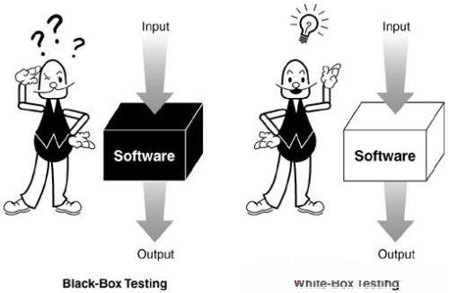
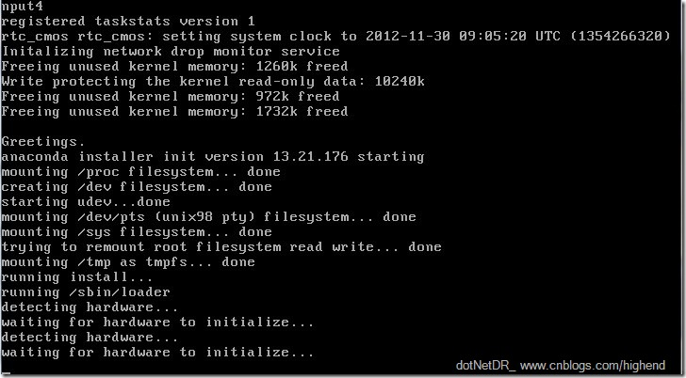
Design of Test Cases
Testing Techniques
Black Box Testing
White Box Testing
Static Testing
Dynamic Testing

Slide 17
Design of Test Cases
Black-box testing
Characteristics of Black-box testing:
Program is treated as a black box.
Implementation details do not matter.
Requires an end-user perspective.
Criteria are not precise.
Test planning can begin early.

Slide 18
Design of Test Cases
Dynamic black-box testing
Dynamic black-box testing is testing without having an insight into the details of the underlying code.
Dynamic, because the program is running
Black-box, because testing is done without knowledge of how the program is implemented.
Sometimes referred to as behavioral testing.
Requires an executable program and a specification (or at least a user manual).
Test cases are formulated as a set of pairs
E.g., (input, expected output)

Slide 19
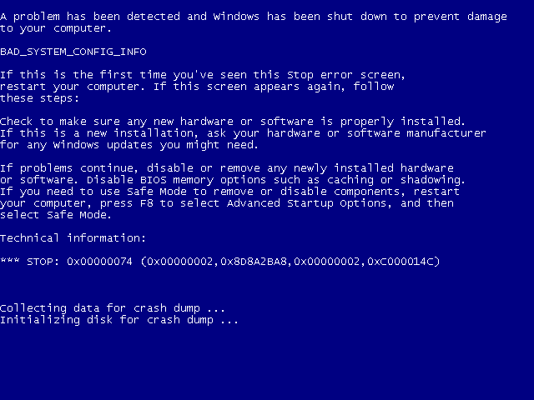
Design of Test Cases

Slide 20
Black-box Testing
Requirements
Output
B
Running SW
Given
Input A
Events

Slide 21
Black-box Testing
Test-to-pass and Test-to-fail
Test-to-pass:
assures that the software minimally works,
does not push the capabilities of the software,
applies simple and straightforward test cases,
does not try to “break” the program.
Test-to-fail:
designing and running test cases with the sole purpose of breaking the software.
strategically chosen test cases to probe for common weaknesses in the software.

Slide 22
Black-box Testing
Test Data and Test Cases
Test data: Inputs which have been devised to test the system.
Test cases: Inputs to test the system and the predicted outputs from these inputs if the system operates according to its specification.

Slide 23
Black-box Testing
Black-box testing

Slide 24


Black-box Testing
Test Case for a Bar
1 Beer
2 Beers
65536 Beers
-1 Beer
Adfsdagdsg Beer
锟斤拷烫烫烫 Beer
Where is the toilet?

Slide 25

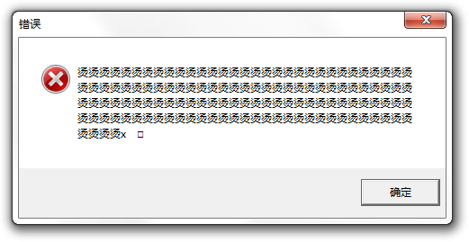

Black-box Testing

Slide 26
Black-box Testing
Obviously, we need something that defines the software--i.e. requirements document or specification document.
We must be able to specify what should be produced as output B, given input A.
We do NOT need to know HOW output B is produced from input A.
Although we can’t look at code, we may ask the programmers questions about numeric limits, internal quirks of the software etc.

Slide 27
Black-box Testing
Testing Methods in Black Box Testing
Random Testing
Equivalence Partitioning
Boundary Value Analysis
Cause Effect Analysis

Slide 28
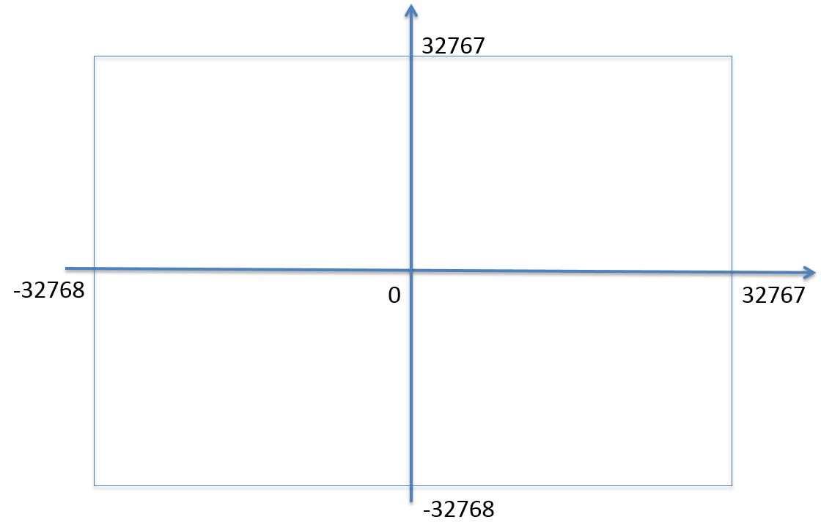
Random Testing
Test cases are generated purely at random [SWEBOK v3.0]
Input domain must be known
Pick random points within input domain
Automation
int Add(const int &a, const int &b)
{
return a+b;
}

Slide 29
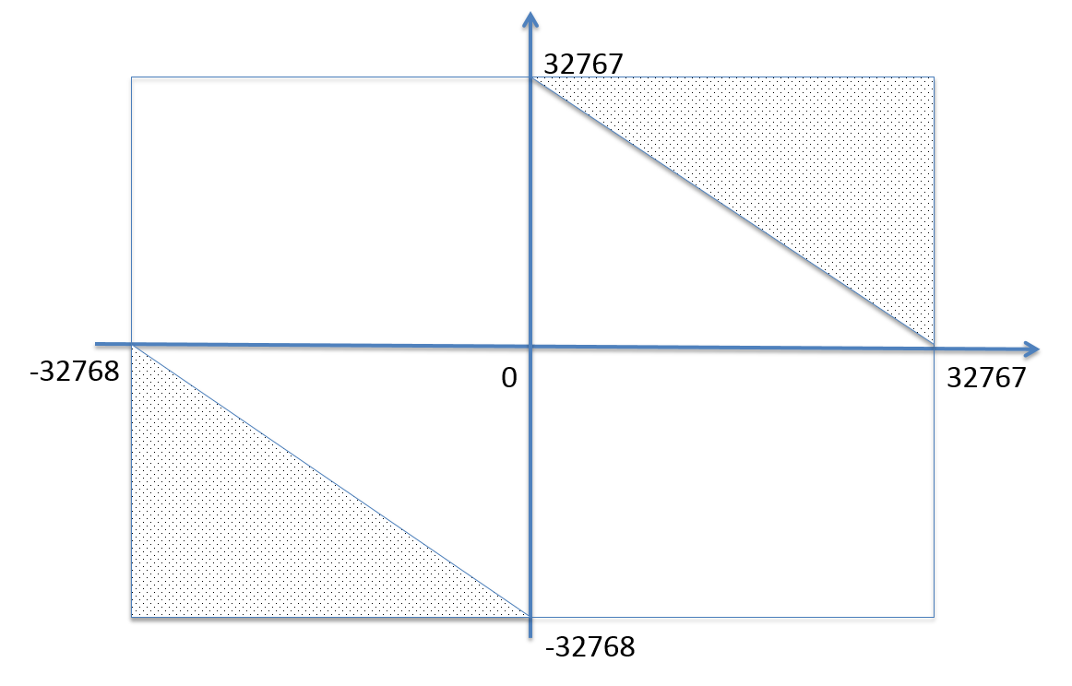
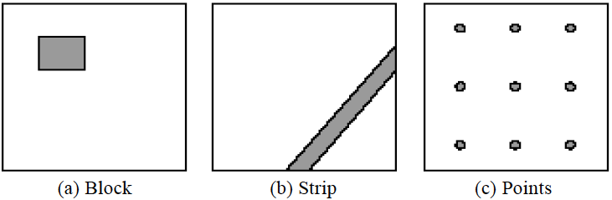
Adaptive Random Testing
int Add(const int &a, const int &b)
{
return a+b;
}
Typical patterns of failure-causing regions

Slide 30
Adaptive Random Testing
A passed test, nearby tests may be passed
A failed test, nearby tests may be failed
So, select test cases far away from others …

Slide 31
Black-box Testing
Testing Methods in Black Box Testing
Random Testing
Equivalence Partitioning
Boundary Value Analysis
Cause Effect Analysis

Slide 32
Define equivalence partitions - or classes
Equivalence partitioning helps us cut down the number of test cases without adding a great deal of risk.
Normally we look at two areas for testing:
- Data
- Logic flow
There are many guidelines for picking equivalence partitions.
Note: These are guidelines, not hard and fast rules.

Slide 33
Data Testing QUIDELINES FOR CHOOSING EQUIVALENCE CLASSES
Identify boundary conditions - data that is at the edge of the planned operational limits of the software.
For the boundaries, partition input into
- Valid data inside the boundary.
- Data just on the boundary (which may be valid or invalid).
- Invalid data just outside the boundary limits.
Boundary conditions should be identified in the requirements or the specifications.

Slide 34
Equivalence Partitioning 1
Idea is to partition the input space into a number of equivalence classes such that one could expect, based on the specification, that every element of a given class would be ‘‘handled’’ (i.e., mapped to
an output) in the same manner
(either correctly or incorrectly),
thus reducing the total number of test cases that must be developed.
Two types of classes are identified:
valid (corresponding to inputs deemed valid from the specification)
invalid (corresponding to inputs deemed erroneous from the specification)

Slide 35
Equivalence Partitioning 2
Divide all possible inputs into classes (partitions) such that : There is a finite number of input equivalence classes
You may reasonably assume that
The program behaves analogously for inputs in the same class
One test with a representative value from a class is sufficient
If the representative detects a fault, then other class members would detect the same fault
i₁
i₄
i₂
i₃
all inputs

Slide 36
Equivalence Classes
Valid data
User supplied commands.
Responses to system prompts.
File names.
Computational data:
Physical parameters,
Bounding values, and
Initiation values.
Output data formatting commands.
Responses to error messages.
Graphical data.
Invalid data
Data outside bounds of the program.
Physically impossible data.
Proper value supplied in wrong place.

Slide 37
Equivalence Classes Strategy
Identify input equivalence classes
Based on conditions on inputs/outputs in specification/description: Both valid and invalid input equivalence classes
Based on heuristics and experience :
“input x in [1..10]” → classes : x < 1, 1 ≤ x ≤ 10, x > 10
“enumeration A, B, C“ → classes : A, B, C, not{A,B,C,}
"input intege → classes : n not an integer, n < min, min ≤ n < 0, 0 ≤ n ≤ max, n > max
……
Define one/couple of test cases for each class
Test cases that cover valid classes
Test cases that cover at most one invalid class

Slide 38
Equivalence Partitioning Example 1
Partition system inputs into groups (partitions) that should cause
equivalent behaviour, include both valid and invalid inputs.
If input is a 5-digit integer between 10,000 and 99,999,
Equivalence partitions are:
< 10,000 10,000 - 99,999 > 99,999

Slide 39
Equivalence Partitioning Example 2
Identify (multiple sets of disjoint) equivalence classes for the following program specification fragment.
City Tax Specification:
1. If gross pay is no more than $30,000, the tax is 1%.
2. If gross pay is more than $30,000, but no more than $50,000, the tax is 5%.
3. If gross pay is more than $50,000, the tax is 15%.

Slide 40
Equivalence Partitioning 3
1. If input is a range, one valid and two invalid equivalence classes:
less than range
in range
greater than range
2. If input is a specific value, one valid and two invalid equivalence classes:
less than value
value
greater than value
3. If input is a set of related values, one valid and one invalid class:
not member of set
member of set
4. If input is Boolean, one valid and one invalid class:
nonBoolean
Boolean

Slide 41
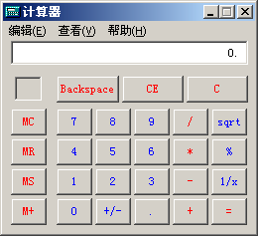
Equivalence Partitioning Example 3
Test for addition operation of MS calculator.
Class 1: Integer
Class 2: Decimal fraction
Class 3: Negative
Class 4: Invalid input

Slide 42
Further Partitioning Possibilities
Check default, empty, blank, null, zero, and no data.
- If nothing is entered, what happens?
- Default set?
- Error message?
- Hung program?
Check invalid, wrong, incorrect, and garbage data.
- Users WILL use the software incorrectly.
- Data loses or crashes are blamed on the software, always --- not the user
- Have fun with this one --- devious, tricky, and nasty are good traits for a tester!

Slide 43
Black-box Testing
Testing Methods in Black Box Testing
Random Testing
Equivalence Partitioning
Boundary Value Analysis
Cause Effect Analysis

Slide 44
Black-Box testing - Boundary Value Analysis (BVA)
A technique based on identifying, and generating test cases to explore boundary conditions.
Boundary conditions are an extremely rich source of errors.
Natural language based specifications of boundaries are often ambiguous, as in ‘‘for input values of X between 0 and 40,...’’
May be applied to both input and output conditions.
Also applicable to white box testing.
more errors occur at the boundaries of an input domain than in the “center”

Slide 45
Boundary Values
Based on experience / heuristics :
Testing boundary conditions of eq. classes is more effective i.e. values directly on, above, and beneath edges of classes
Choose input boundary values as tests in input classes instead of, or additional to arbitrary values
Choose also inputs that invoke output boundary values ( values on the boundary of output classes )
Example strategy as extension of equivalence partitioning:
choose one (n) arbitrary value(s) in each eq. class
choose values exactly on lower /upper boundaries of eq. class
choose values immediately below /above each boundary ( if applicable )

Slide 46
Guidelines for Identifying Boundary Values
1. If the input range is bounded by a and b, then use a, b, and values just above and just below a and b, respectively.
a
b
2. If the input is a number of values, use the minimum and maximum of the values and values just above and just below them, respectively.
a
b
3. Apply guidelines 1 and 2 to create output values at the minimum and maximum expected values.
4. If data structures have boundaries, test these boundary values and values just above and just below them, respectively.
e.g., for an array of bounds 1 to 10 — test array index equal to 0, 1,2, 9, 10, 11

Slide 47
BVA Example 1
Test a function for calculation of absolute value of an integer
Valid equivalence classes :
Condition Valid eq. classes Invalid eq. Classes
particular abs < 0, >= 0
Test cases :
class x < 0, arbitrary value: x = -10
class x >= 0, arbitrary value x = 100
classes x < 0, x >= 0, on boundary : x = 0
classes x < 0, x >= 0, below and above: x = -1, x = 1

Slide 48
BVA Example 2
Test a function which limit user input to 6-digit positive integer
Test cases :
Class arbitrary value: X1 = 123123
Class boundary value: X2 = 12345
Class boundary value: X3 = 1234567
Class boundary value: X4 = 1
Class boundary value: X5 = 0
Class invalid value: X6 = -123123
Class invalid value: X7 = asdasd
Others?
Class invalid value: X8 = 000123
X9 = asd123;
X10 = Empty

Slide 49
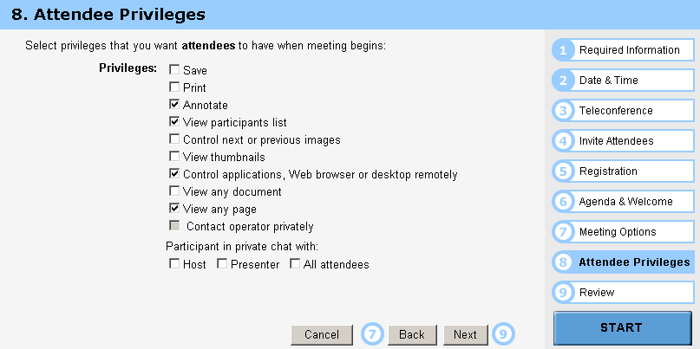
BVA Example 3
Test cases :
Class arbitrary value: Random select some options Class boundary value: Select all options Class boundary value: Select none option Class boundary value: Select 1 option

Slide 50
Other types in Boundary
First/last
Min/Max
Star/Finish
Empty/Full
Slower/Faster
Largest/Smallest
Over/Under
Shortest/Longest
… …
Numeric
Character
Position
Quantity
Speed
Location
Size

Slide 51
Examples of possible boundary conditions
Limits on input data – size, type
Limits on output data- size, type
Look for limits such as
First-1/Last+1
Start-1/Finish+1
Min-1/max+1
Less than empty/ more than full
just Over/Just Under
etc.
Don’t hesitate to choose data outside boundaries, even when it seems absurd.

Slide 52
Guidelines for choosing Equivalence classes For Data Testing
Identify sub-boundary conditions or internal boundary conditions
Some limits may not be apparent to the general end user.
To locate some of these, you may need to talk with programmers.
Example: Powers-of-two boundary conditions

Slide 53
Power-of-Two
Binary: 0 and 1, byte is made up of 8 bits, word is made up of 4 bytes, …
Term | Range or Value
Bit Nibble Byte Word Kilo Mega Giga Tera | 0 or 1 0-15 <Half byte> 0-255 0-65535 or 0-4294967295 1024 1048576 1073741824 1099511627776

Slide 54
EXAMPLE: Powers-of-Two
Often a programmer will handle data differently depending upon its size.
Example: Communications software where with limited bandwidth, we try to keep the size of data being transmitted low.
Program transmits 256 commands, but uses only a nibble (4 bits) to encode the 15 most commonly used commands.
Thus, there is an internal boundary between the 4th and 5th bit
Might try transmitting 3, 4, 5 bits in addition to ones determined by the stated boundary conditions of 1 and 8 bits.

Slide 55
An Example: A flight simulator
Assume the user can control the height of the plane, determine what those limits are:
Not specified?
Why not?
Nothing in a computer is infinite!
Try flying
Below ground
In outer space
Through a mountain (or some other object)

Slide 56
ASCII Table
Character | ASCII Value | Character | ASCII Value
Null Space / 0 1 2 9 ; @ A | 0 32 47 48 49 50 57 58 64 65 | B Y Z [ ‘ a b y z { | 66 89 90 91 96 97 98 121 122 123

Slide 57
ASCII Encoding Always Produce Sub-Boundary Conditions
The ASCII code is 8 bits.
If numeric digits are to be input,
check just out of range with the ‘/’ and ‘:’
If capital letters are to be input,
check just out of range with the ‘@’ and ‘[‘
If lower case letters are to be input,
check just out of range with the forward quote and the ‘{‘.
Character | ASCII Value | Character | ASCII Value
Null Space / 0 1 2 9 ; @ A | 0 32 47 48 49 50 57 58 64 65 | B Y Z [ ‘ a b y z { | 66 89 90 91 96 97 98 121 122 123
NOTE: The error in using the default settings in the PowerPoint software. In each case, I encased the character in a single quote--- i.e. the key below “.

Slide 58
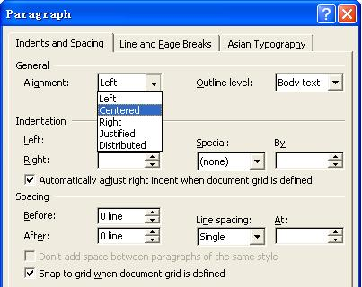
Text-box Field
Default
Empty
Blank
Null
Zero
None

Slide 59
Black-box Testing
Testing Methods in Black Box Testing
Random Testing
Equivalence Partitioning
Boundary Value Analysis
Cause Effect Analysis

Slide 60
Cause-Effect Analysis
Cause-Effect Analysis is a systematic means for generating test cases to cover different combinations of input ‘‘Causes’’ resulting in output ‘‘Effects.’’
A CAUSE may be thought of as a distinct input condition, or an ‘‘equivalence class’’ of input conditions.
An EFFECT may be thought of as a distinct output condition, or a meaningful change in program state.
Causes and Effects are represented as Boolean variables and the logical relationships among them CAN (but need not) be represented as one or more boolean graphs.

Slide 61
Cause-Effect Analysis Sample 1
Given inputs maxint and N compute result :
|N|
∑
result = if this <= maxint, error otherwise
k
K=0
Valid equivalence classes : condition valid eq. classes . abs(N) N < 0, N ≥ 0 maxint ∑ k ≤ maxint, ∑ k > maxint
Test Cases :
maxint N result maxint N result
55 10 55 100 0 0 54 10 error 100 -1 1 56 10 55 100 1 1 0 0 0 … … …

Slide 62
Cause-Effect Analysis
How to combine the boundary conditions of different inputs ?
Take all possible boundary combinations ?
This may blow up ……

Slide 63
Cause-Effect Analysis 2
Systematic method for generating test cases representing combinations of conditions
Combinatorial explosion of number of possible combinations
Some heuristics to reduce this combinatorial explosion
Starting point is effects (outputs) then working ‘backwards’
‘light-weight’ formal methods: transformation into semi-formal Boolean graph
A technique : to be combined with others

Slide 64
Cause-Effect Analysis Sample 3
∑ k ≤ maxint
∑ k > maxint
N < 0
N ≥ 0
and
∑ k
error
and
xor
Causes ∑ k ≤ maxint 1 1 0 0
Inputs ∑ k > maxint 0 0 1 1
N < 0 1 0 1 0
N ≥ 0 0 1 0 1
Effects ∑ k 1 1 0 0
Outputs error 0 0 1 1

Slide 65
Cause-Effect Analysis 3
Black-box technique to analyze combinations of input conditions
Identify causes and effects in specification ↓ ↓ inputs outputs current state new state
Make Boolean Graph linking causes and effects
Annotate impossible combinations of causes and effects
Develop decision table from graph with in each column a particular combination of inputs and outputs
Transform each column into test case

Slide 66
C-E Analysis Process Steps
Cause-effect graphing consists of the following 4 steps
List and label causes (input-events) and effects (output actions) for a module
Draw a cause-effect graph describing the logical combinations of causes, intermediate causes and resulting effects,
Develop a decision table (causes vs effects) from the graph
Convert each row into a test case, or a set of rows into a testing scenario

Slide 67
Cause-Effect Analysis Sample 4
Case Matrix:
Cause
∑ k ≤ maxint
1
1
0
0
∑ k > maxint
0
0
1
1
N < 0
1
0
1
0
N ≥ 0
0
1
0
1
Effects
∑ k
1
1
0
0
error
0
0
1
1

Slide 68
To be continued… See you next week

